Slide 1

ILP 2023 – W6S1 Dictionaries and Object-oriented thinking
Matthieu DE MARI – Singapore University of Technology and Design

Slide 2
Outline (Week6, Session1 – W6S1)
The tuple type (fast version)
The dictionary type
Dictionary and objects
Object-oriented thinking and programming
(If time allows, tuples and sets types extra practice)

Slide 3
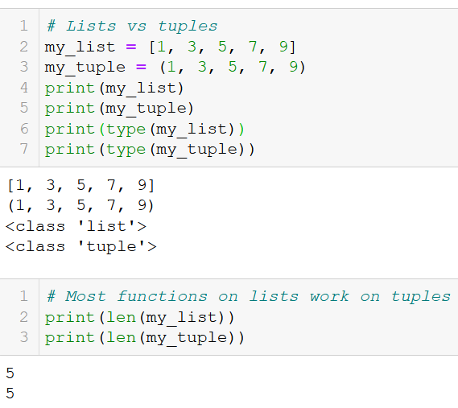
The tuple type
Tuples are collections of variables, very similar to lists, but have their elements listed between parentheses (), instead of brackets [].
They share many functions with lists, such as the len() function for instance.

Slide 4
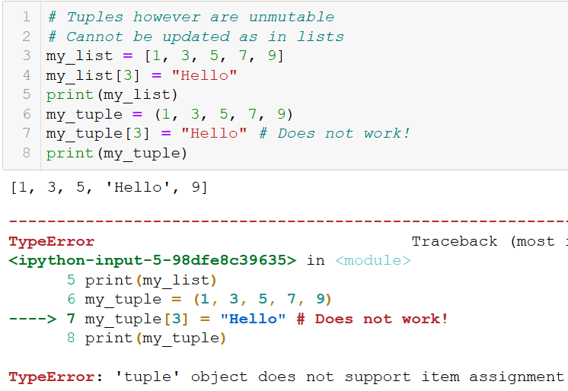
The tuple type
As with lists, tuples objects can be
Indexed, Sliced,
Traversed using for loops,
Etc.
However, the major difference between lists and tuples is that tuples, just like strings, are UNMUTABLE.
Unmutable: values can only be changed on creation. No updates.

Slide 5
The tuple type
As with lists, tuples objects can be
Indexed, Sliced,
Traversed using for loops,
Etc.
However, the major difference between lists and tuples is that tuples, just like strings, are UNMUTABLE.
Unmutable: values can only be changed on creation. No updates.
→ Added practice on tuples (for those interested) in the extra practice folder on today’s materials!

Slide 6
The dict type
Dictionaries (dict) are the last type of built-in object we will cover during this course.

Slide 7
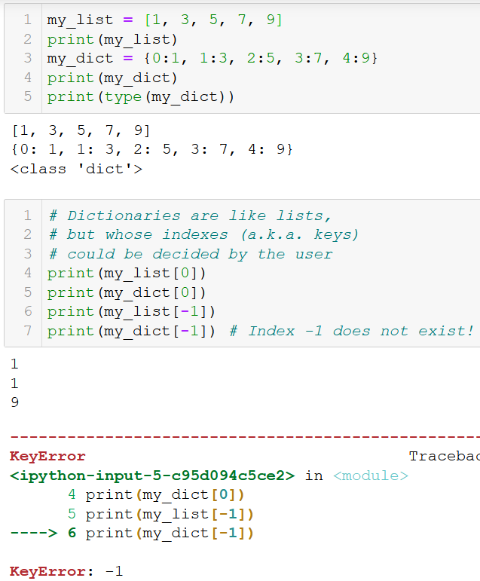
The dict type
Dictionaries (dict) are the last type of built-in object we will cover during this course.
They operate as lists.
But they give the user the possibility to choose custom indexes/keys to use for elements.

Slide 8
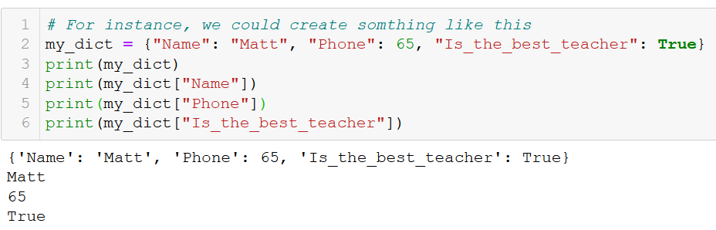
The dict type
Dictionaries (dict) operate as lists. But they give the user the possibility to choose custom indexes/keys to use for elements.
This opens plenty of new possibilities, for instance

Slide 9
The dict type
Dictionaries (dict) operate as lists. But they give the user the possibility to choose custom indexes/keys to use for elements.
This opens plenty of new possibilities, for instance
More on this later!

Slide 10
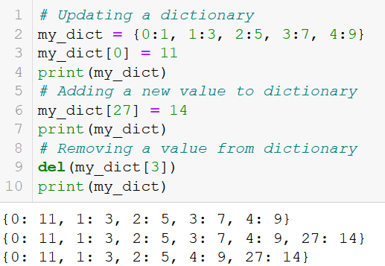
Adding, updating and removing elements
As with lists, we can update elements using the brackets [] notation.
If the key/index did not exist in the dictionary, it will add a new entry to the dictionary.

Slide 11
Adding, updating and removing elements
As with lists, we can update elements using the brackets [] notation.
If the key/index did not exist in the dictionary, it will add a new entry to the dictionary.
As with lists, we can also remove an element from the dictionary with del().

Slide 12
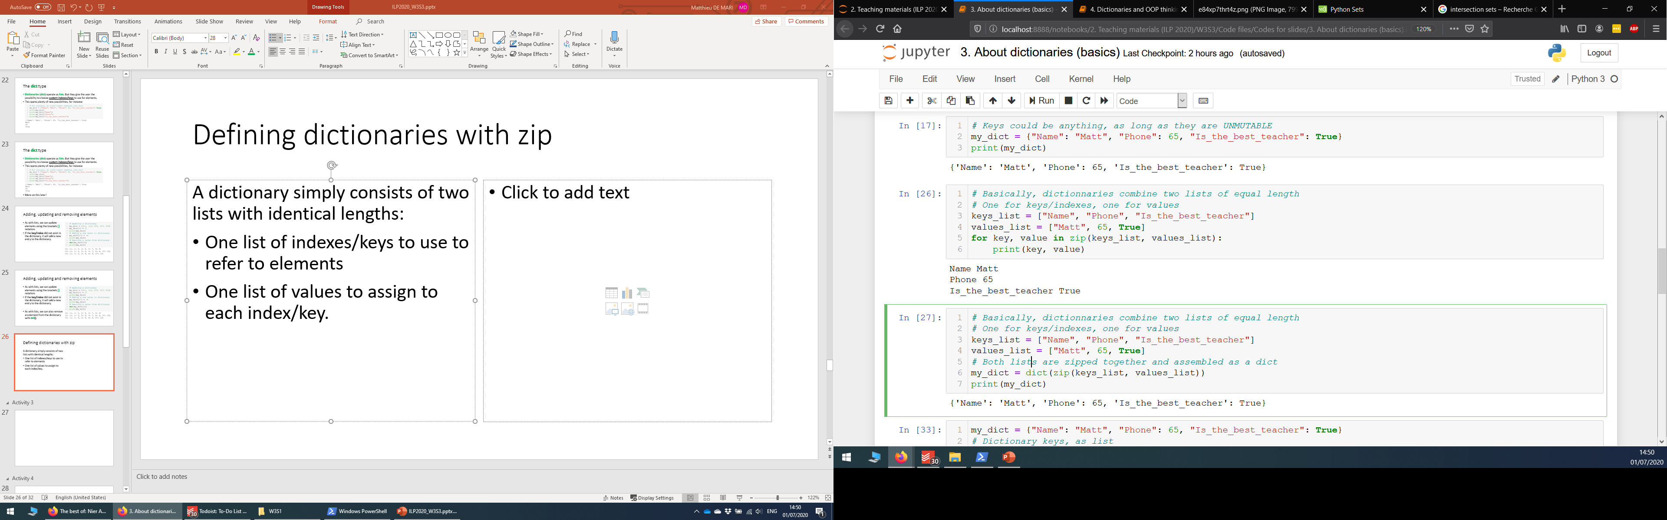
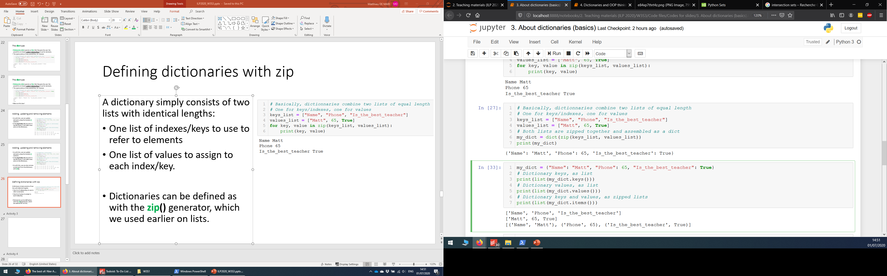
Defining dictionaries with zip
A dictionary simply consists of two lists with identical lengths:
One list of indexes/keys, used to refer to elements
One list of values, assigned to each index/key.
Dictionaries can be defined as with the zip() generator, which we used earlier to combine lists.

Slide 13
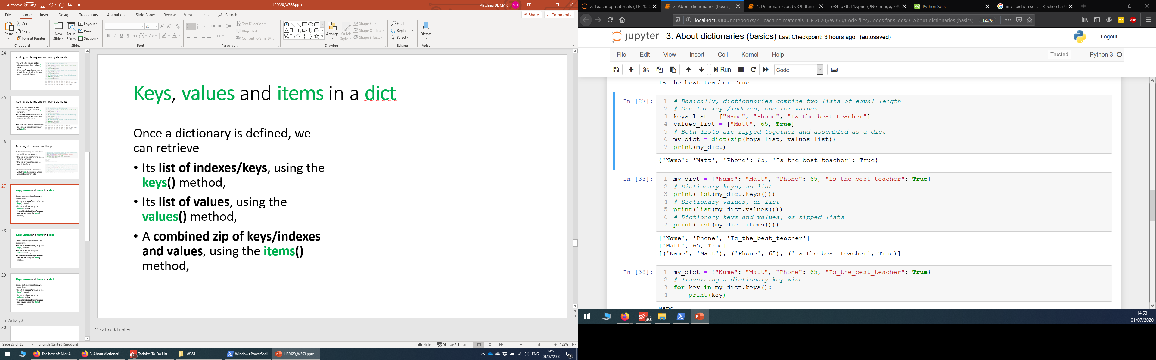
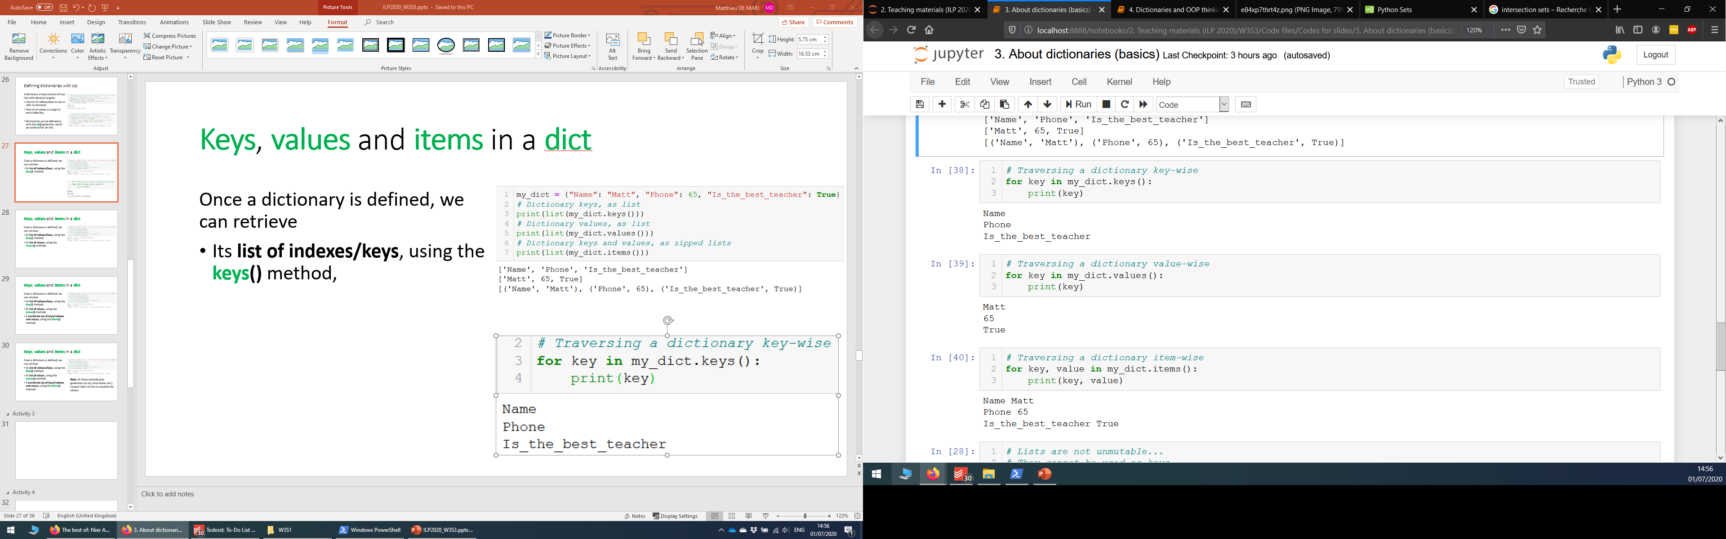
Keys, values and items in a dict
Once a dictionary is defined, we can retrieve
Its list of indexes/keys, using the keys() method,

Slide 14
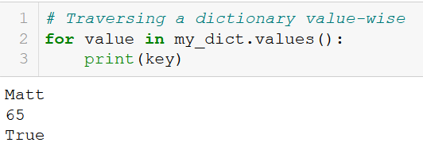
Keys, values and items in a dict
Once a dictionary is defined, we can retrieve
Its list of indexes/keys, using the keys() method,
Its list of values, using the values() method,

Slide 15
Keys, values and items in a dict
Once a dictionary is defined, we can retrieve
Its list of indexes/keys, using the keys() method,
Its list of values, using the values() method,
A combined zip of keys/indexes and values, using the items() method.

Slide 16
Keys, values and items in a dict
Once a dictionary is defined, we can retrieve
Its list of indexes/keys, using the keys() method,
Its list of values, using the values() method,
A combined zip of keys/indexes and values, using the items() method.
Note: all three methods give generators (as zip, enumerate, etc.).
Convert them to lists to visualize the values in these generators!

Slide 17
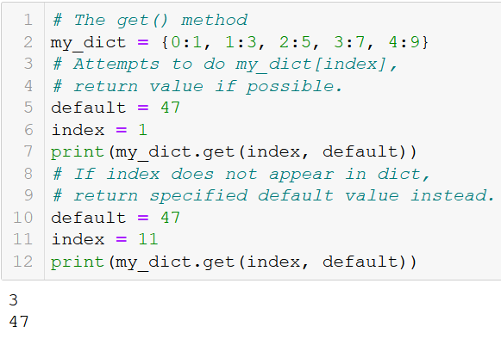
The get() method
Finally, dictionaries provide a get() method, which receives two arguments.
The first argument is an index/key. The get() method attempts to retrieve the value in the dict for the given index/key.

Slide 18
The get() method
Finally, dictionaries provide a get() method, which receives two arguments.
The first argument is an index/key. The get() method attempts to retrieve the value in the dict for the given index/key.
If the index/key does not exist, it returns the default value specified as the second argument of get().

Slide 19
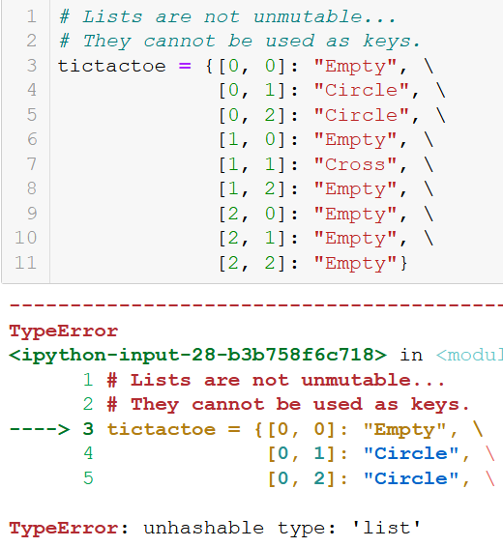
A note on keys
Important note on keys: the keys of a dict need to be UNMUTABLE types of variables.
Unmutables types: ints, floats, strings, tuples, sets, etc.
Mutable types: lists, etc.

Slide 20
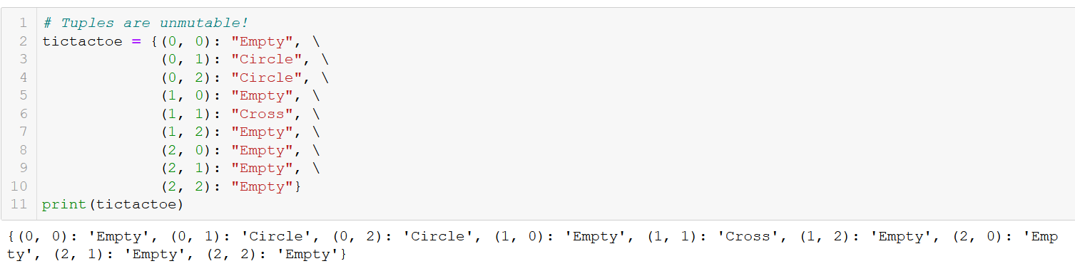
A note on keys
Important note on keys: the keys of a dict need to be UNMUTABLE types of variables.

Slide 21

Matt’s Great advice #12
Matt’s Great Advice #12: Get comfortable with dictionaries.
Dictionaries are one of the most important types in Python.
While they might seem abstract at first, they are pretty easy to work with, especially if you understood the concepts behind lists.
Practice until you get comfortable with them, as we will be using them a lot!

Slide 22
Matt’s Great advice #13
Matt’s Great Advice #13: Everything is an object.
Everything in the world can be described, to some extent, using a dictionary with several attributes.
EVERYTHING.
This school of thought/paradigm is commonly referred to as object-oriented programming.

Slide 23
Object oriented programming and thinking
Object Oriented Programming (OOP) is a programming paradigm that relies on the concept of objects.

Slide 24
Object oriented programming and thinking
Object Oriented Programming (OOP) is a programming paradigm that relies on the concept of objects.
It is used to structure a software program into simple, reusable pieces of code/blueprints (usually called objects) which are used to create individual instances of self-contained objects.
This paradigm is a game-changer, but we will merely cover the basic concepts during this Summer School.
Here, I propose an introduction to OOP, as “Object Oriented Thinking”.

Slide 25
I believe this calls for a demo…

Slide 26
I believe this calls for a demo…
Time to discuss about these “guys”.

Slide 27


Slide 28
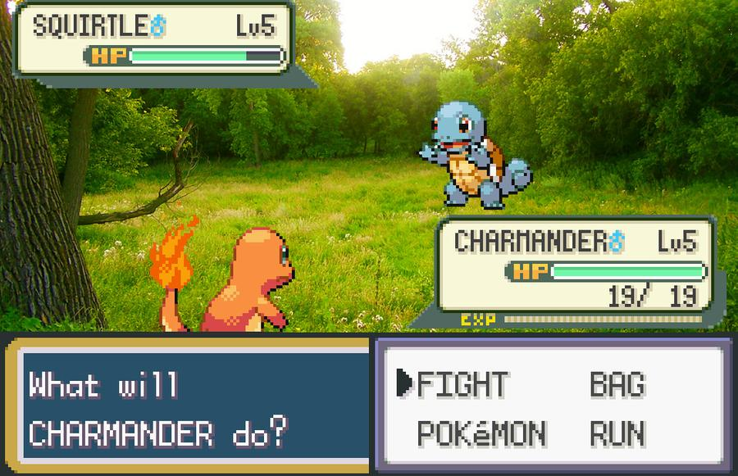

Slide 29
Pokemons as programming objects
Following the OOP paradigm, Pokemons can be viewed and described as programming objects, with several attributes, such as:
A name: as a string variable
A level: as an int
An elemental type: as a string variable
Some hitpoints (HP), strength and defense points.
Etc.
Therefore, they could be described, by using a dictionary with several entries, one for each attribute.

Slide 30

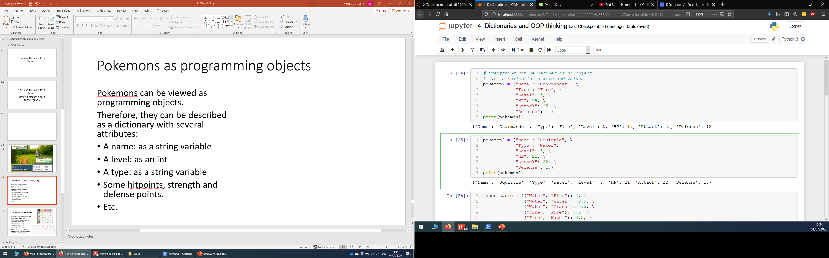
Pokemons as programming objects

Slide 31
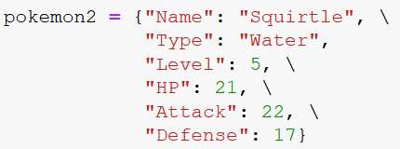

Slide 32
Pokemons types tables
Pokemons have an elemental type (Fire, Water, Grass, etc.)

Slide 33
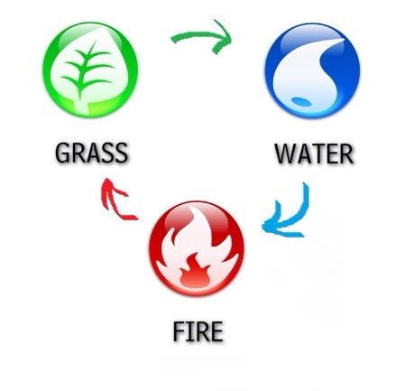
Pokemons types tables
Pokemons have an elemental type (Fire, Water, Grass, etc.)
The Pokemon game has a rock-paper-scissor concept.
Fire strong vs. Grass,
Water strong vs. Fire,
Grass strong vs. Water.

Slide 34
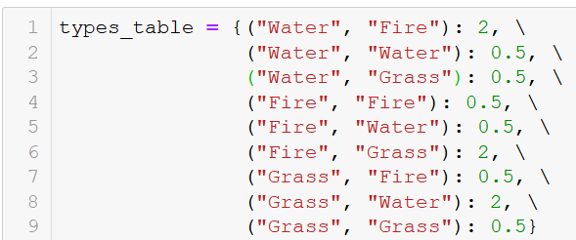
Pokemons types tables
Pokemons have an elemental type (Fire, Water, Grass, etc.)
The Pokemon game has a rock-paper-scissor concept.
Fire strong vs. Grass,
Water strong vs. Fire,
Grass strong vs. Water.
Strong means you deal double damage in combat, weak means you deal half damage only.

Slide 36
ATTACK!

Slide 37
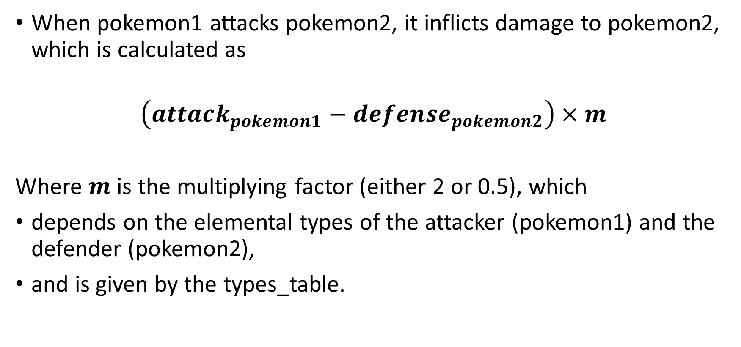
The attack function
When pokemon1 attacks pokemon2, it inflicts damage to pokemon2, which is calculated as
$$\left(attack_{pokemon1}−de{fense}_{pokemon2}\right)×m$$
Where $m$ is the multiplying factor (either 2 or 0.5), which
depends on the elemental types of the attacker (pokemon1) and the defender (pokemon2),
and is given by the types_table.

Slide 38
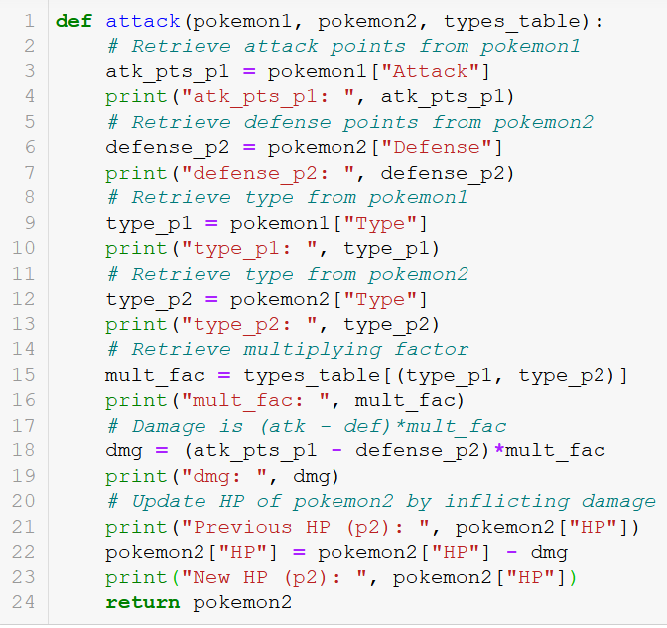

Slide 39
ATTACK! attack(pokemon1,
pokemon2,
types_table)

Slide 40
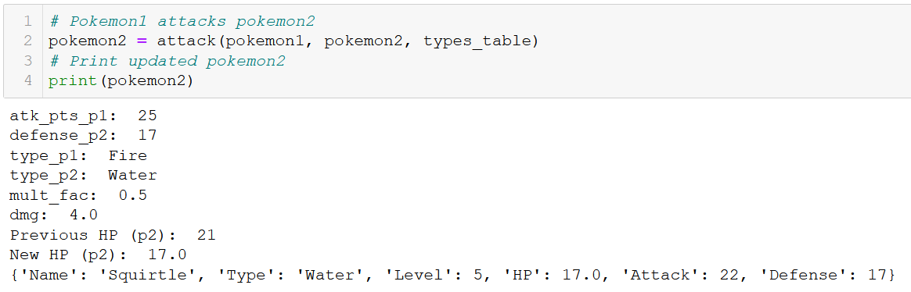
The attack function, at work

Slide 41
Going deeper
Pokemon is a game with a gameplay that goes far deeper than just this basic “attack” gameplay mechanic.
However, I believe that this example helped visualize how OOP can help improve the structure of your code!

Slide 42
About OOP
Object Oriented Programming (OOP) is a programming paradigm that relies on the concept of objects.
In OOP, everything can be described as an object.

Slide 43
About OOP
Object Oriented Programming (OOP) is a programming paradigm that relies on the concept of objects.
In OOP, everything can be described as an object.
You have seen here how it could be done using a dictionary. In practice however, OOP goes far deeper, and gives the possibility to create:
Your own custom types of variables, so that you can represent any object you want.
Your own custom methods, i.e. functions that will only apply to these custom objects.

Slide 44
About OOP
Object Oriented Programming (OOP) is a programming paradigm that relies on the concept of objects.
In OOP, everything can be described as an object.
You have seen here how it could be done using a dictionary. In practice however, OOP goes far deeper, and gives the possibility to create:
Your own custom types of variables, so that you can represent any object you want.
Your own custom methods, i.e. functions that will only apply to these custom objects.
TO BE COVERED IN
W6S2 AND W6S3!

Slide 45
Activity 3 - Hero stats
In OOP, a function, which creates an object and its dictionary, based on a few variables, is called a constructor function for the object.
In this activity, we design a constructor function for a hero object.
Write a function create_hero(), which receives three parameters:
str_pts: an int corresponding to the strength points of the hero,
agi_pts: an int corresponding to the agility points of the hero,
int_pts: an int corresponding to the intelligence points of the hero.

Slide 46
Activity 3 - Hero stats
It returns a dictionary containing the following keys and values:
str_pts: an int corresponding to the strength points of the hero,
agi_pts: an int corresponding to the agility points of the hero,
int_pts: an int corresponding to the intelligence points of the hero,
HP_pts: an int corresponding to the life points of the hero, which is 10 points, plus 10 times the number of strength points,
MP_pts: an int corresponding to the magic points (MP) of the hero, which is 5 times the number of intelligence points,
atk_pts: an int corresponding to the attack points of the hero, which is the sum of the strength, agility and intelligence points.

Slide 47
Activity 4 - Equipping a weapon
Let us consider the hero defined below as an object, with its own dictionary.
hero_dict = {'str_pts': 10, 'equipped_weapon': None, 'atk_pts': None}
Notice how no attack points and equipped weapon have yet been defined (they instead have the None value).
We can also define weapons objects, as dictionaries as well. Below we have defined two weapon objects: a sword and a bow.
sword = {"weapon_name": "Sword of Blazing Justice", "weapon_atk": 10}
bow = {"weapon_name": "Bow of Impeccable Accuracy", "weapon_atk": 8}

Slide 48
Activity 4 - Equipping a weapon
Write a function equip_weapon(), which receives two dictionaries:
The first one is a hero dictionary,
The second one is a weapon dictionary (either the sword or bow).
It will return the hero dictionary, whose keys, 'equipped_weapon' and 'atk_pts', have been updated.
The value assigned to the 'equipped_weapon' of the hero dictionary, will be the dictionary corresponding to the equipped weapon.
The value assigned to the 'atk_pts' of the hero dictionary, will consist of the hero strength points (in 'str_pts'), plus the weapon attack points (in the weapon dictionary, key 'weapon_atk').
Note: in practice, this OOP concept defines a 'has-a' relationship, because one of the attributes of the hero object is a weapon object.

Slide 49
Activity 2 - 1337 speak translators v2
You now know about dictionaries.
We will use a translation dictionary, defined below, whose keys are English characters and whose values are the numbers which should replace the said letter, when we translate English sentences into leet speak.
eng_leet_dict = {'I': '1', 'Z': '2', 'E': '3', 'A': '4',
'S': '5', 'T': '7', 'B': '8', 'O': '0’}
This translation dictionary should help you simplify your translation function drastically.

Slide 50
Activity 2 - 1337 speak translators v2
Your objective is then to write a second version of the function eng_to_leet_v2(), which receives two parameters:
the first one is eng_str, which corresponds to a sentence in English, written in capital letters,
the second one is the translation dictionary eng_leet_dict, defined earlier.
The function returns the equivalent sentence in leet speak, modifying the letters with numbers, by following the rules defined earlier.
The translation dictionary should help you simplify your function drastically.

Slide 51
Activity 1 - Find the missing card v2
Write a function find_missing_card(), which receives a deck, in variable deck, as its sole parameter.
The deck is a standard deck that has been shuffled and is missing a card. The function find_missing_card() should then return the one card that is missing in the deck, as a tuple.
Note that the deck is always missing a single card and will contain no duplicates.
Objective: try using a dictionary to count the number of hearts, spades, diamonds, clubs in deck. The one suit with a different number of cards is going to be the suit of the missing card!
suits_dict = {"Hearts": 12, "Spades": 13, "Diamonds": 13, "Clubs": 13}

Slide 52
Conclusion
The tuple type (fast version)
The dictionary type
Dictionary and objects
Object-oriented thinking and programming
(If time allows, tuples and sets types extra practice)

